Slide 1
Hadoop Architecture
Pravin Y Pawar

Slide 2
Conceptual Layer
Conceptually divided into
Data Storage Layer
Data Processing Layer
Data Storage
HDFS
Data Processing
MapReduce

Slide 3
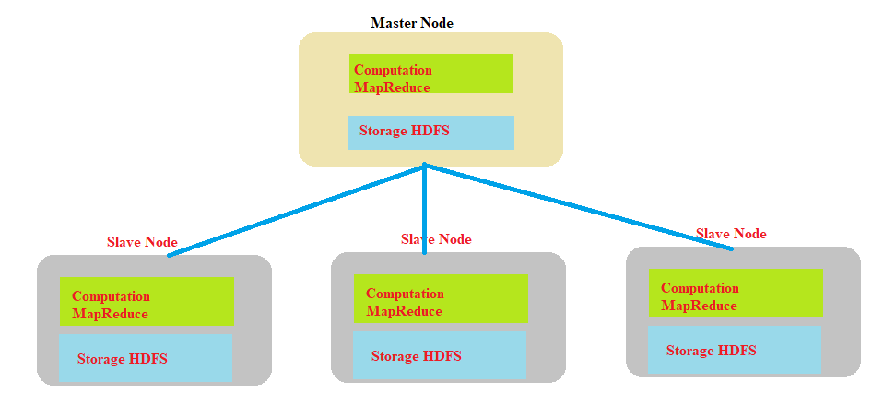
High Level Architecture
Master Slave Architecture
Master Node: NameNode
Slave Node : DataNode
Components of Master Node
Master HDFS
Responsible for partitioning the data storage across slave nodes
Keeps tracks of locations of data on DataNodes
Master MapReduce
Decides and schedules computation
task on slave nodes

Slide 4
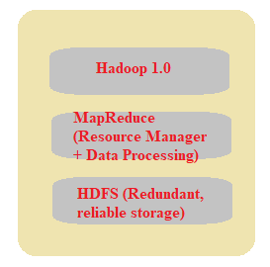
Hadoop Version 1.0
Two main parts
Data Storage Framework
General purpose file system – HDFS – Hadoop Distributed File System
Schema less
Simply stores data files in any format
Provides a lot of flexibility
Data Processing Framework
Simple functional programming model
Formed by Google as MapReduce
Map – take set of key-value pairs and generate intermediate data which is also key-value pair
Reduce – act of the intermediate key-value pairs to output data

Slide 5
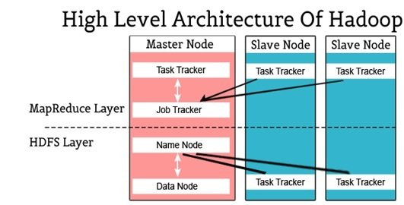
Hadoop High Level Architecture
Image Source : intellipaat

Slide 6
Hadoop Version 1.0
Limitations
Requirement of MapReduce expertise along with proficiency in language like Java
Only supports batch processing jobs like log analysis, data processing
Tightly coupled with MapReduce
Only Two solutions
Needs to adapt the existing data processing program into MapReduce paradigm
Extract data from HDFS and execute the programs in other platforms
None is viable as results into inefficiencies by data movement!

Slide 7
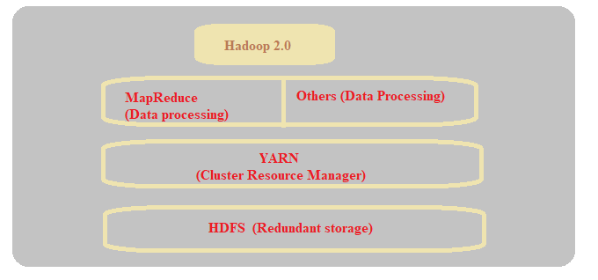
Hadoop Version 2.0
New resource manager YARN – Yet Another Resource Navigator is added
Any application capable of diving itself into parallel tasks is supported by YARN
Takes care of allocations of subtasks of submitted applications
ApplicationMaster instead of JobTracker on Master node
NodeManager instead of TaskTracker on the Slave nodes
Removed dependency on the MapReduce
Supports real time workloads as well

Slide 8
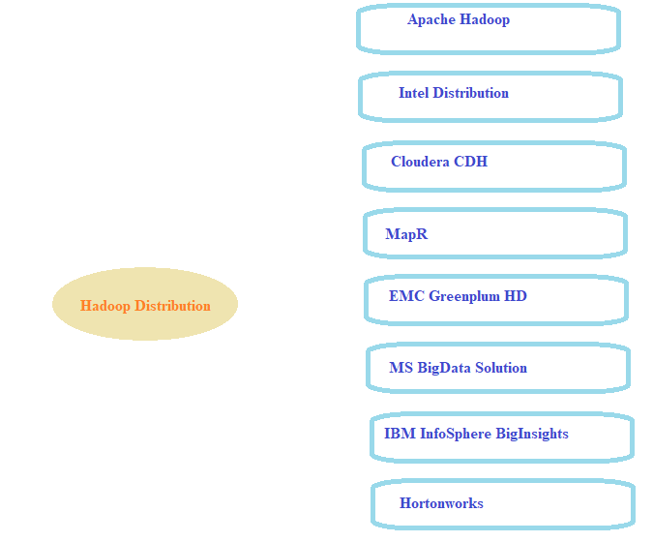
Hadoop Distributions
Open source Apache project
Core components :
Hadoop Common
Hadoop Distributed File System
Hadoop YARN
Hadoop MapReduce

Slide 9
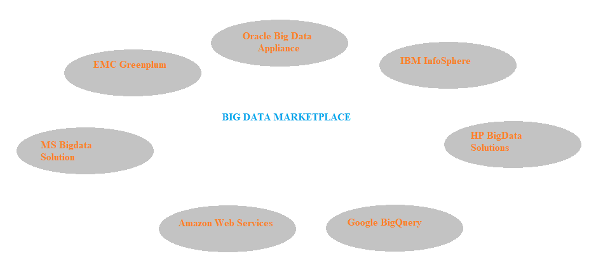
Leading Vendors

Slide 10
Thank You!
Reference :
Big Data and Analytics by Acharya, Chellappan
In our next session: Hadoop Ecosystem

